Slide 1
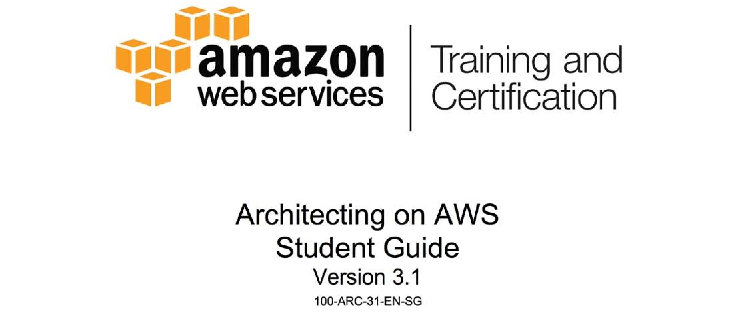
Notes:
1

Slide 2

Module 4: Amazon VPC

Slide 3
Topics
What is Amazon VPC?
Core Components
Key Features

Slide 4
Topics
What is Amazon VPC?
Core components
Key Features

Slide 5
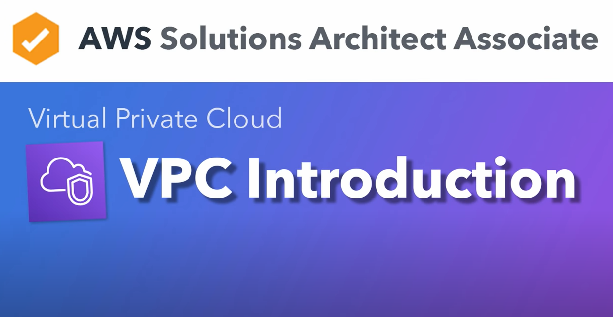

Slide 6
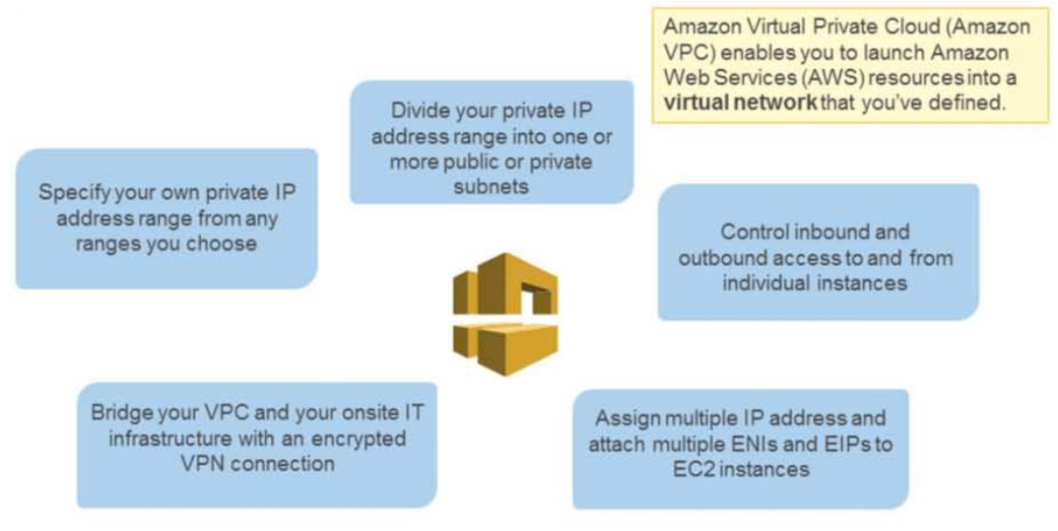
What is Amazon VPC?

Slide 7
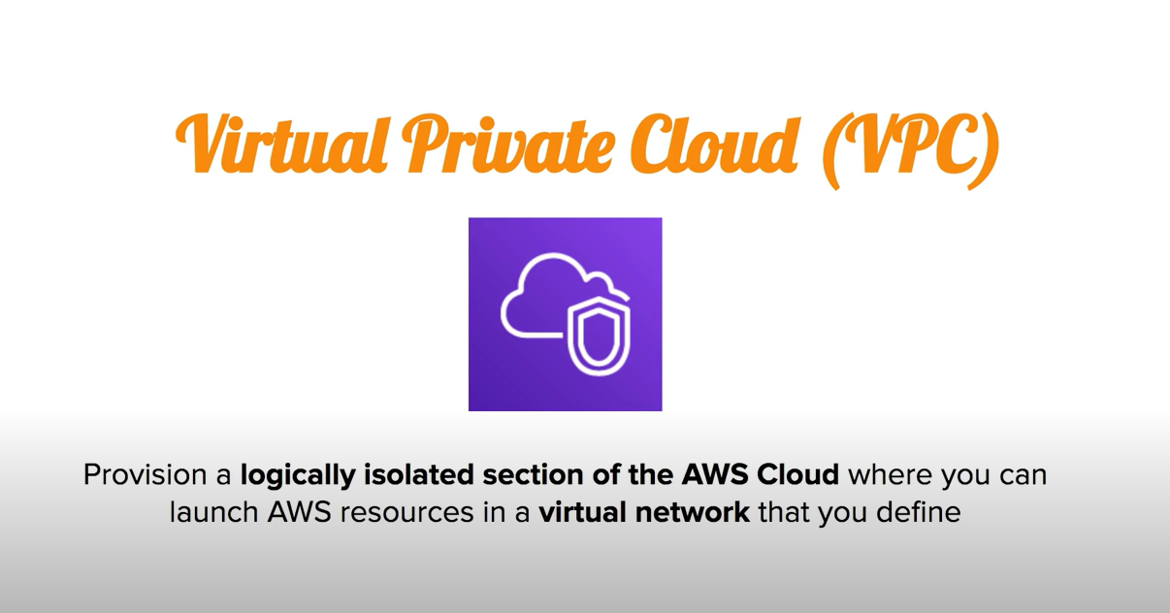

Slide 8
Topics
What is Amazon VPC?
Core components
Key Features

Slide 9
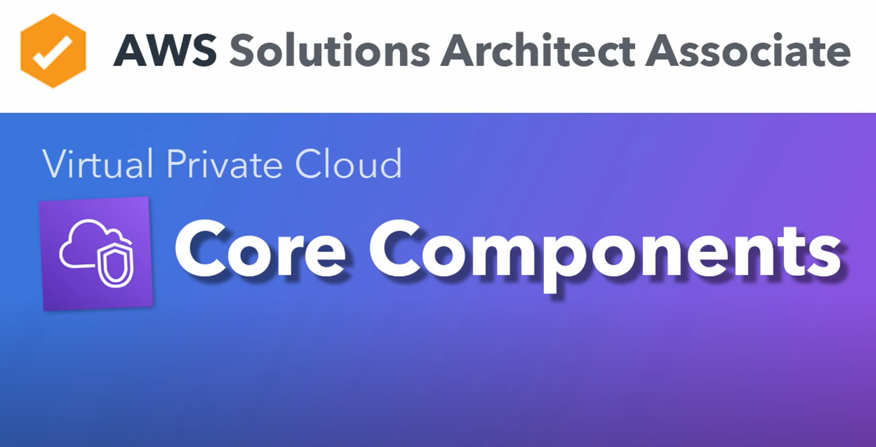

Slide 10
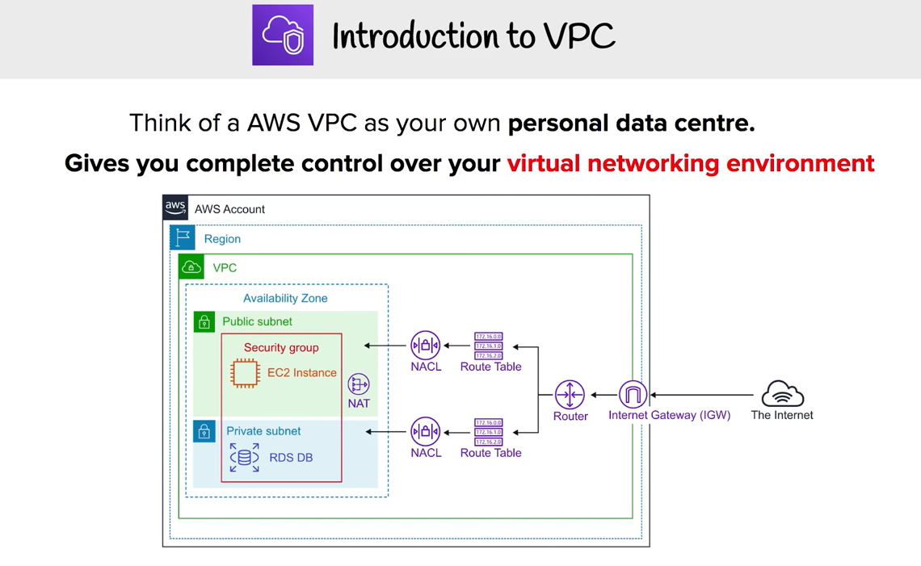

Slide 11
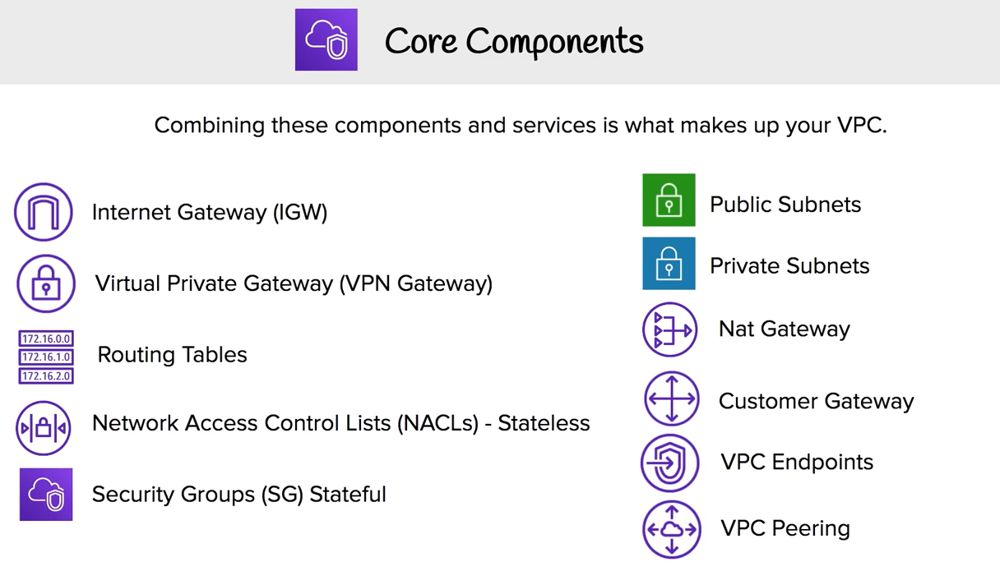

Slide 12
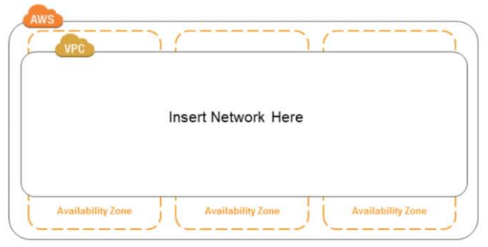
Core components
Select an AWS region for your VPC

Slide 13
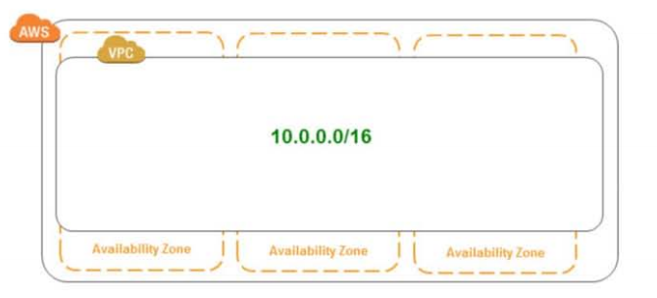
Core components
Specify the size of our network with a CIDR block

Slide 14
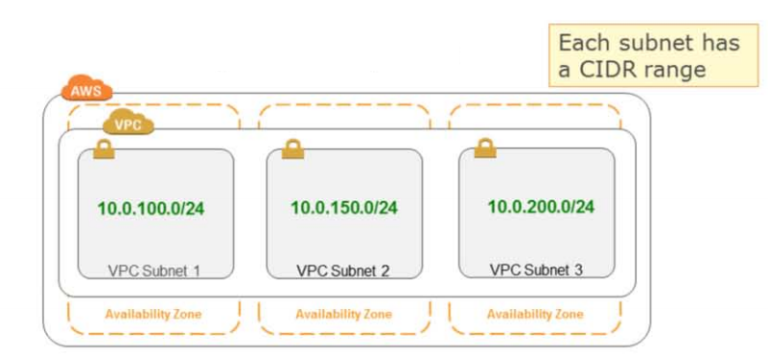
Core components
Create subnets inside the VPC
Subnets do not span Availability Zones

Slide 15
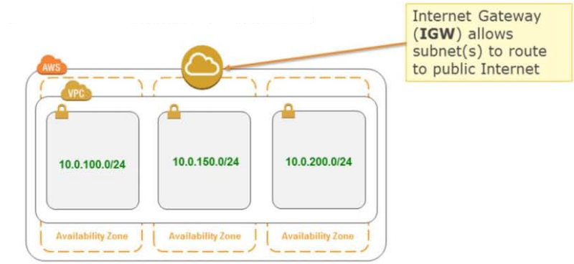
Core components
Attach gateway devices to network

Slide 16
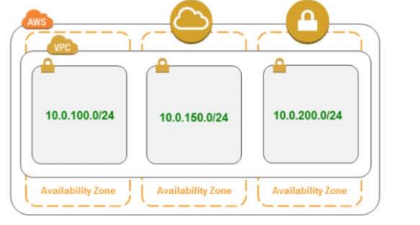
Core components
VPN Gateway(VGW) allows subnet(s) to route to on-premises network over IPSEC VPN

Slide 17
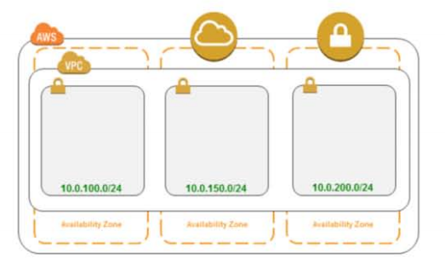
Core components
Define custom routing rule(s) for each subnet

Slide 18
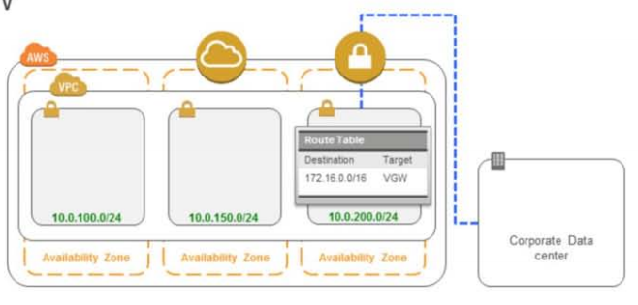
Core components
Private subnet with IPSEC VPN to corporate datacenter via VGW

Slide 19
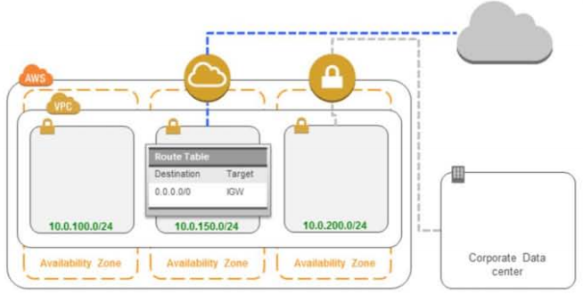
Core components
Public subnet with inbound/outbound Internet connectivity via IGW

Slide 20
Topics
What is Amazon VPC?
Core components
Key Features

Slide 21
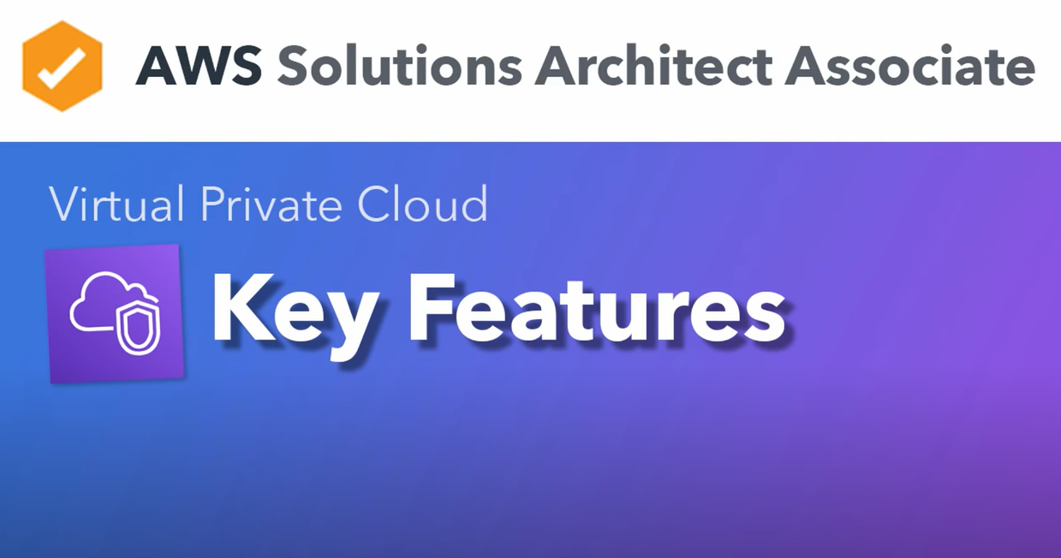

Slide 22
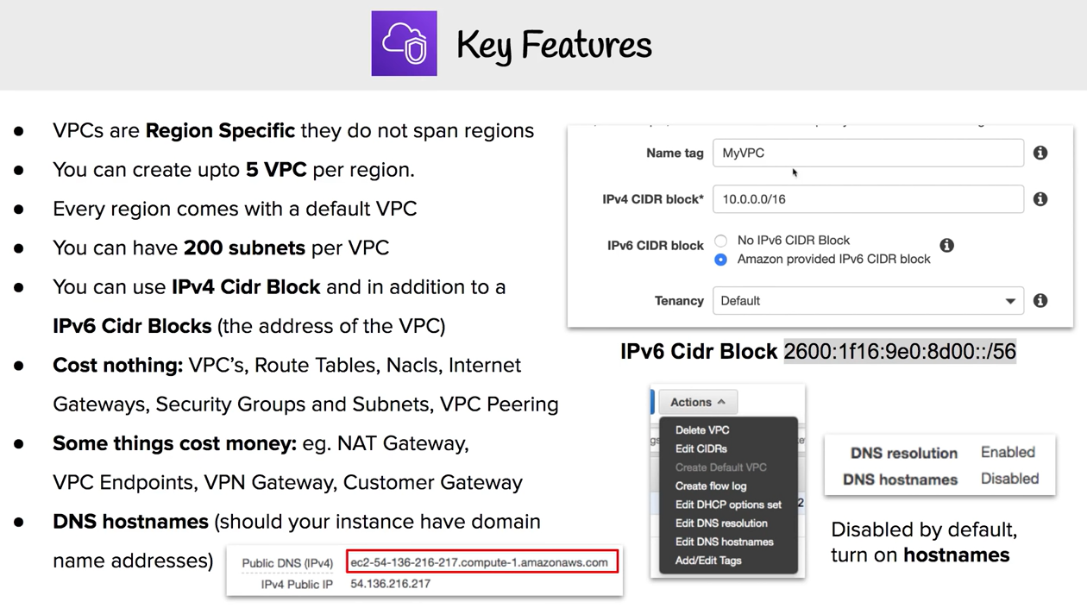

Slide 23
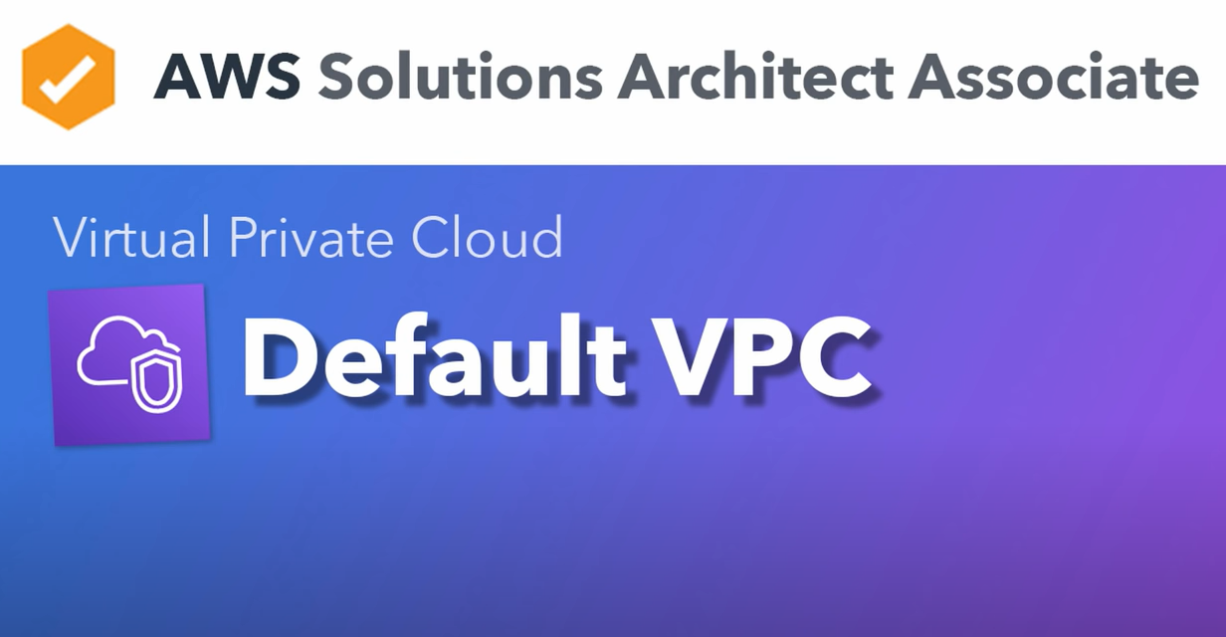

Slide 24
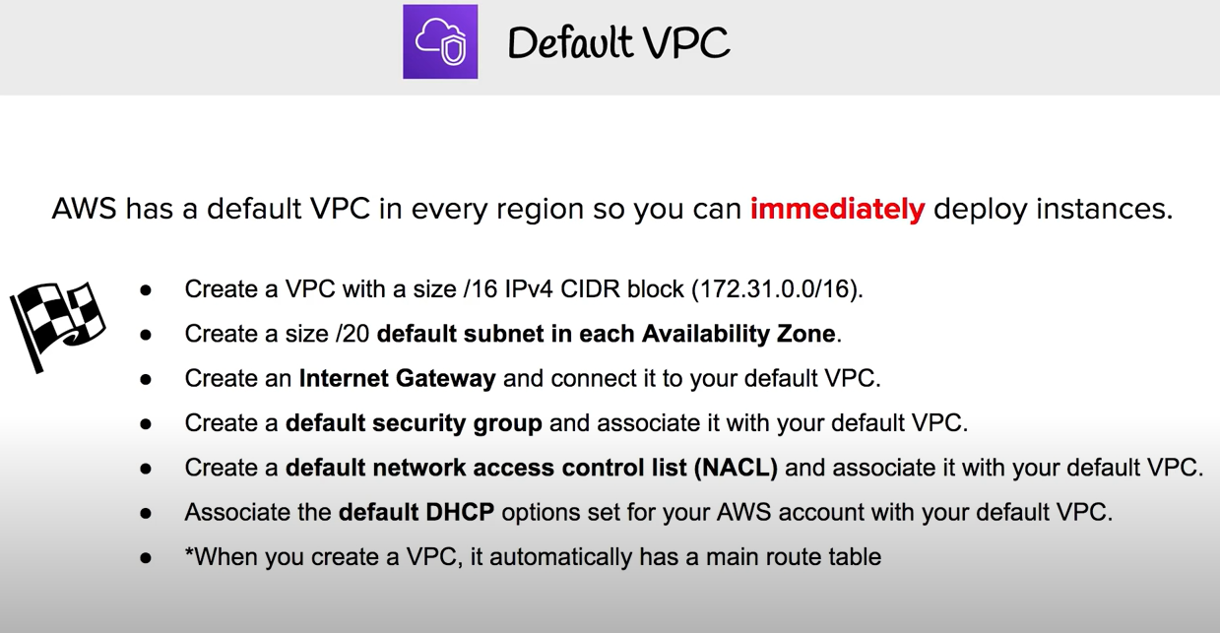

Slide 25
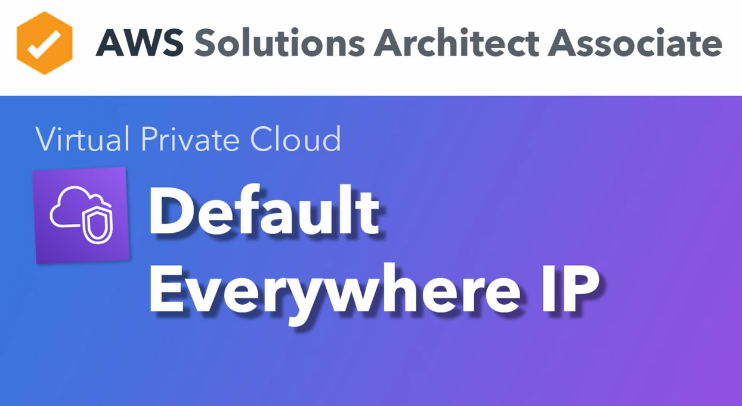

Slide 26
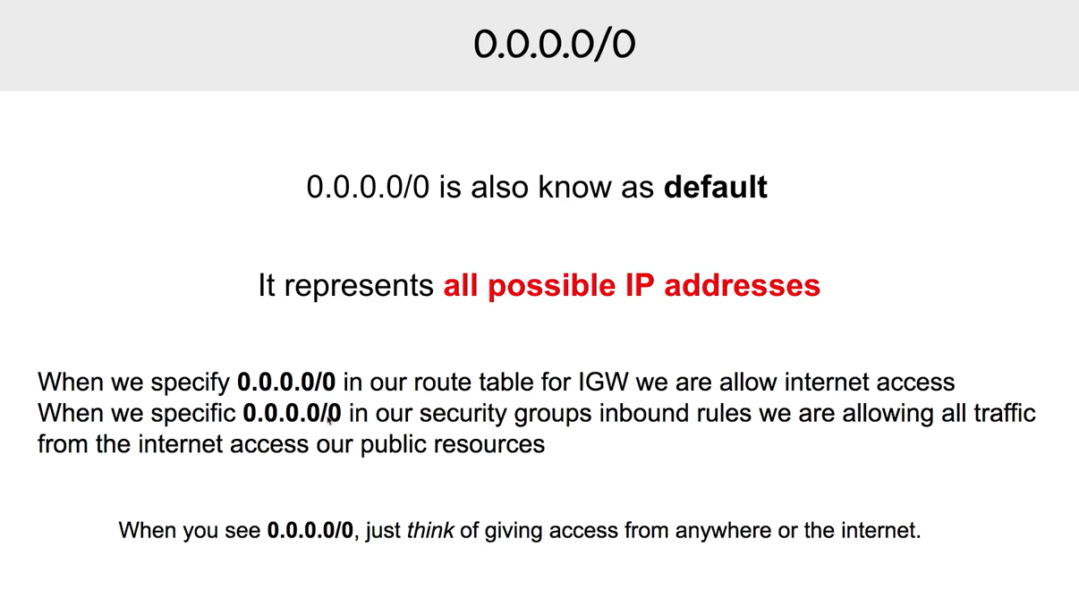

Slide 27
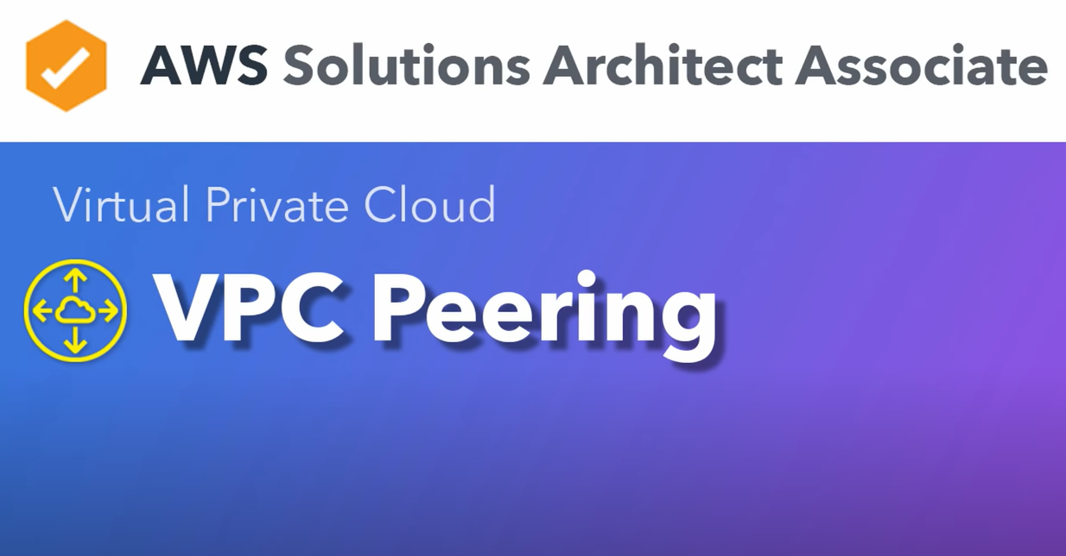

Slide 28
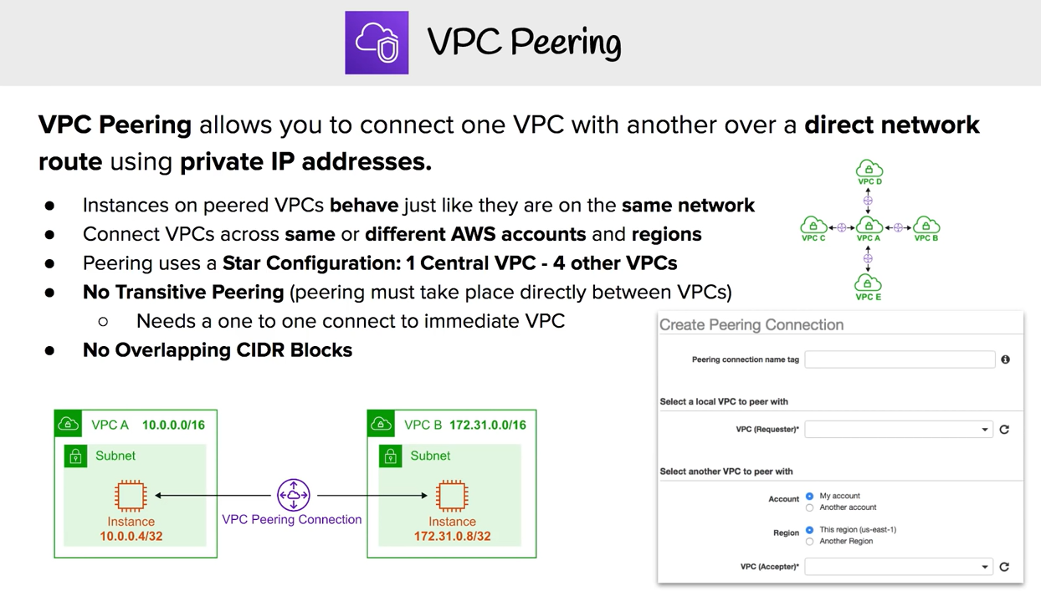

Slide 29
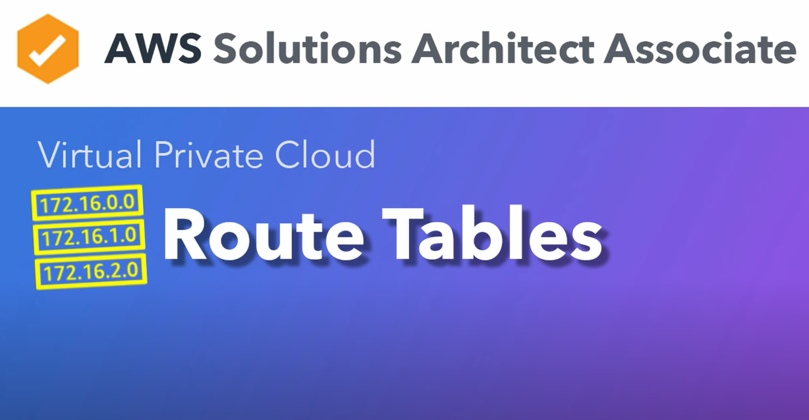

Slide 30
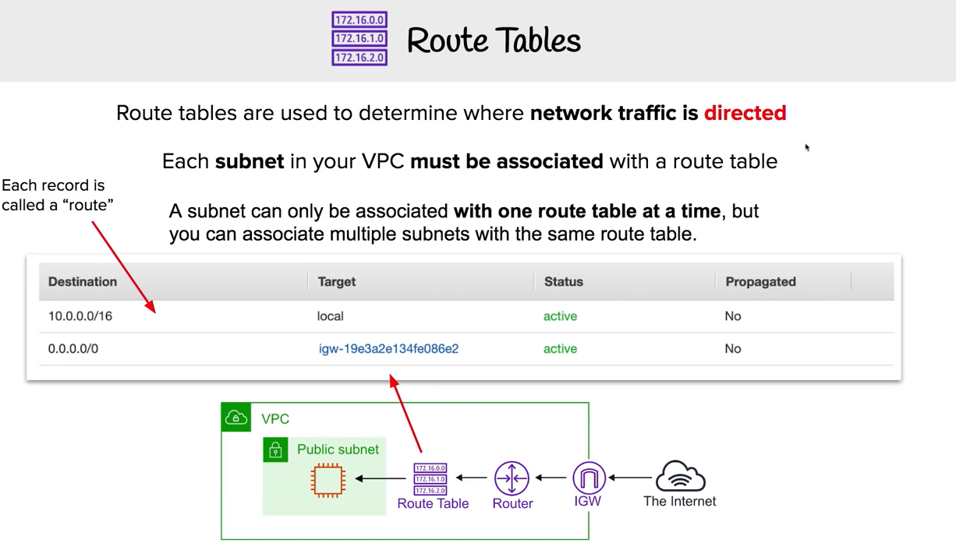

Slide 31
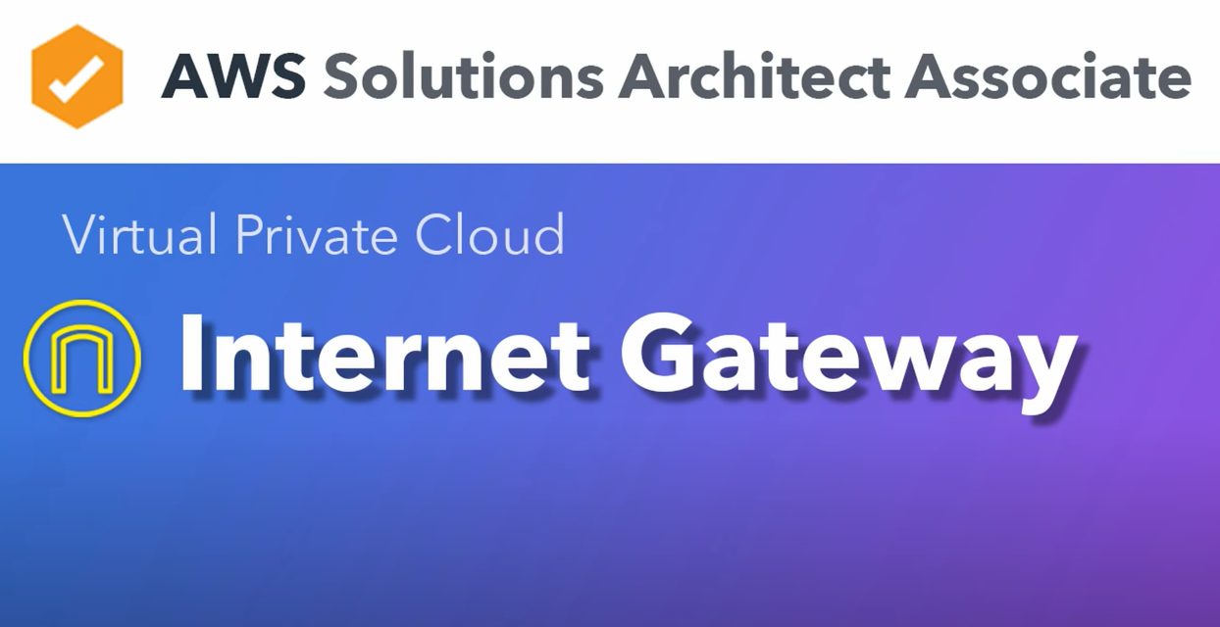

Slide 32
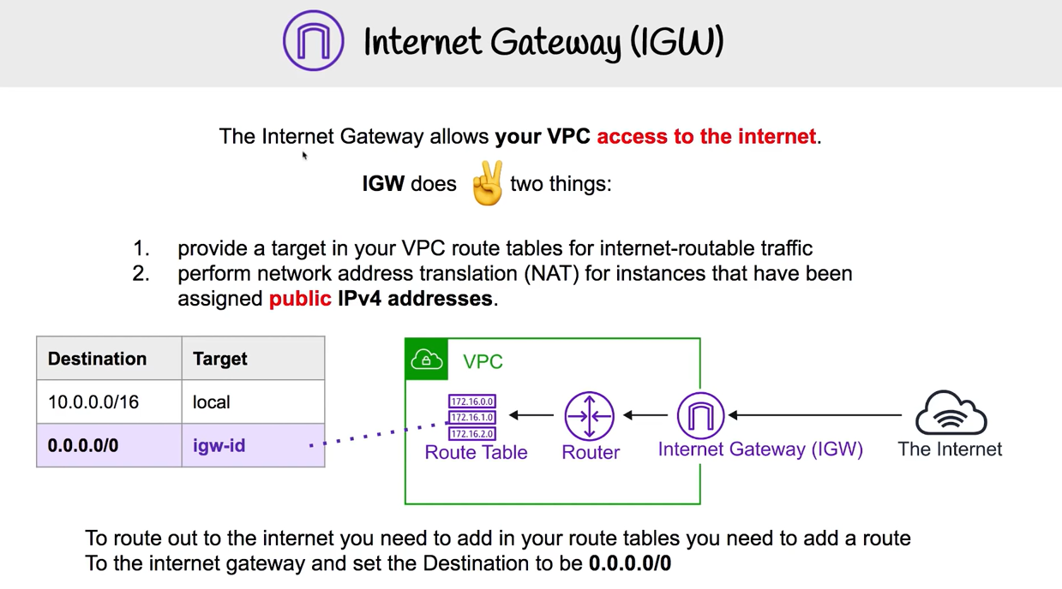

Slide 33
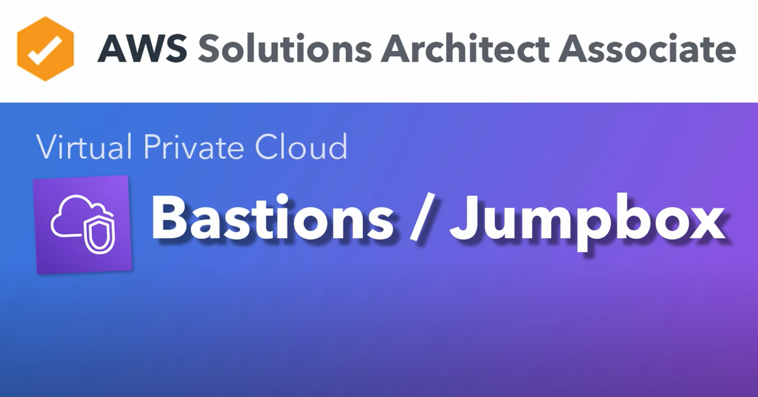

Slide 34
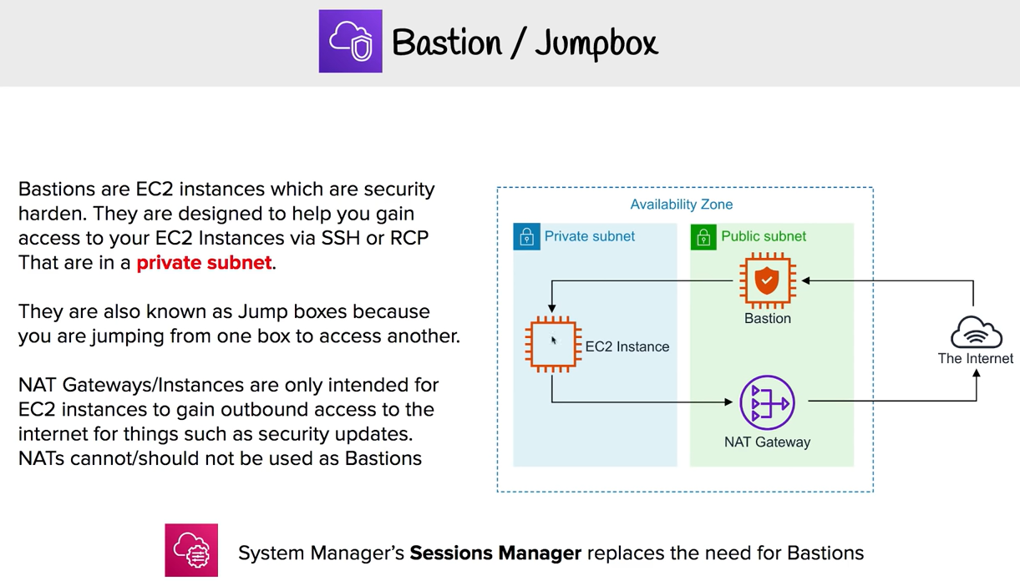

Slide 35
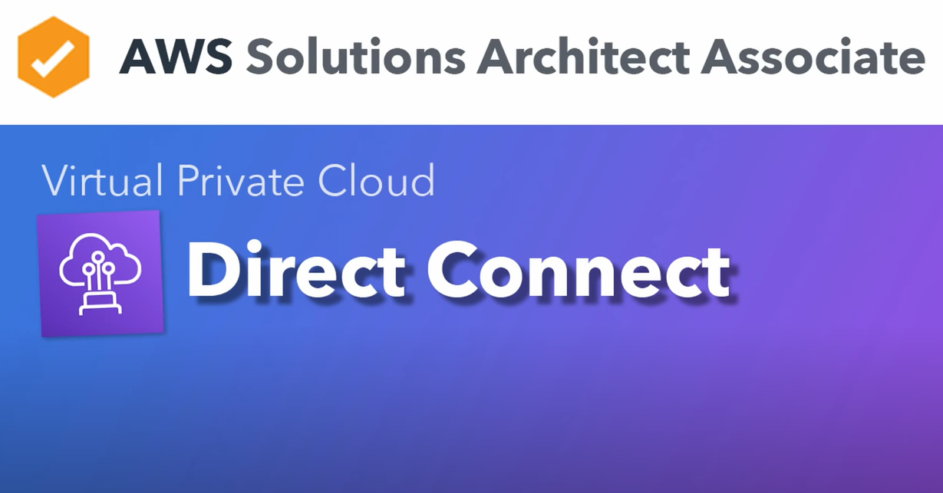

Slide 36
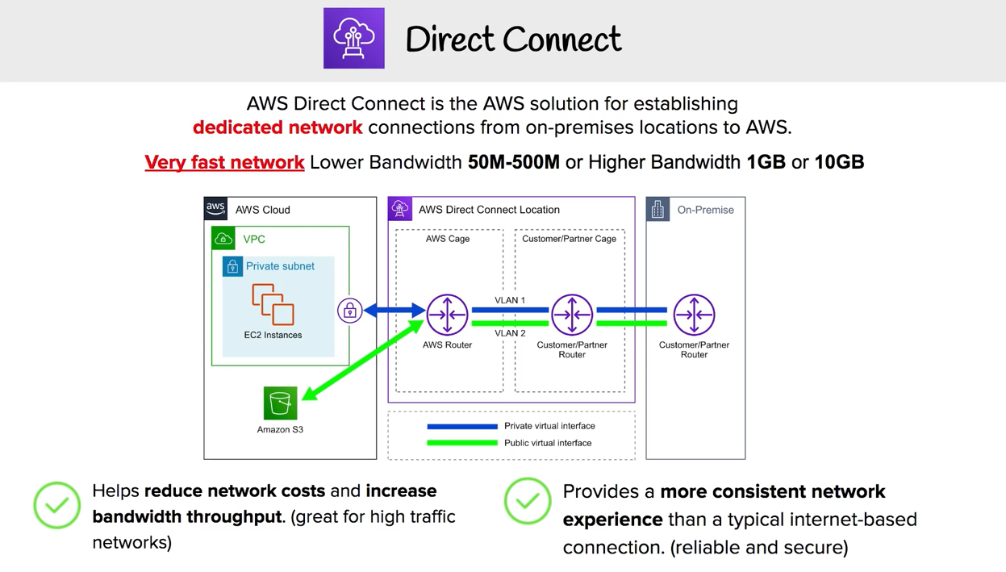

Slide 37
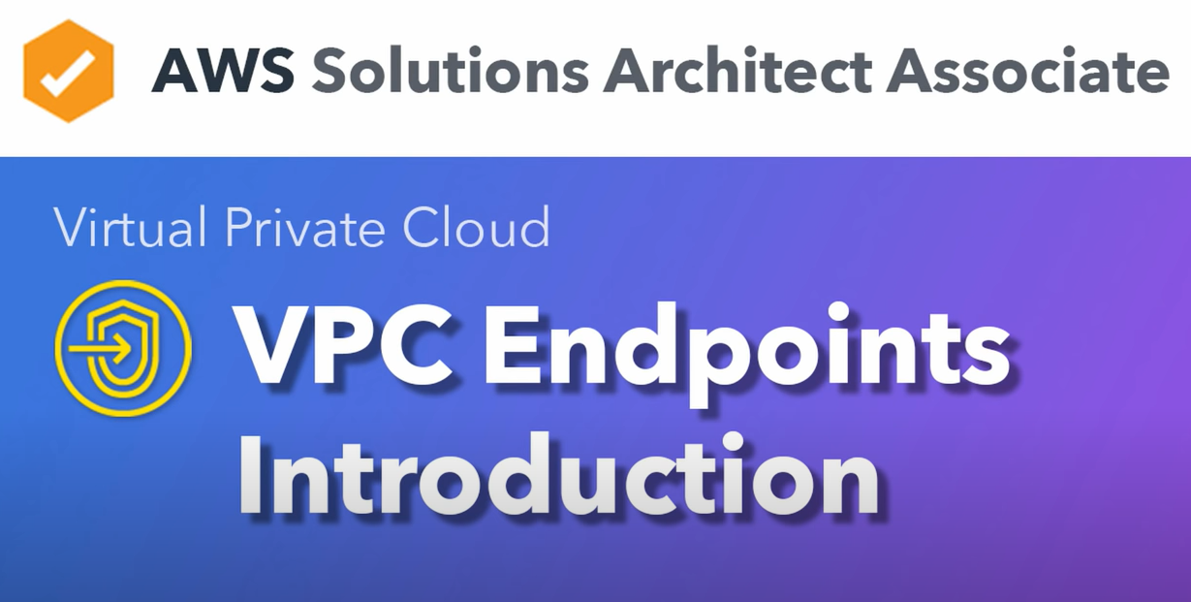

Slide 38
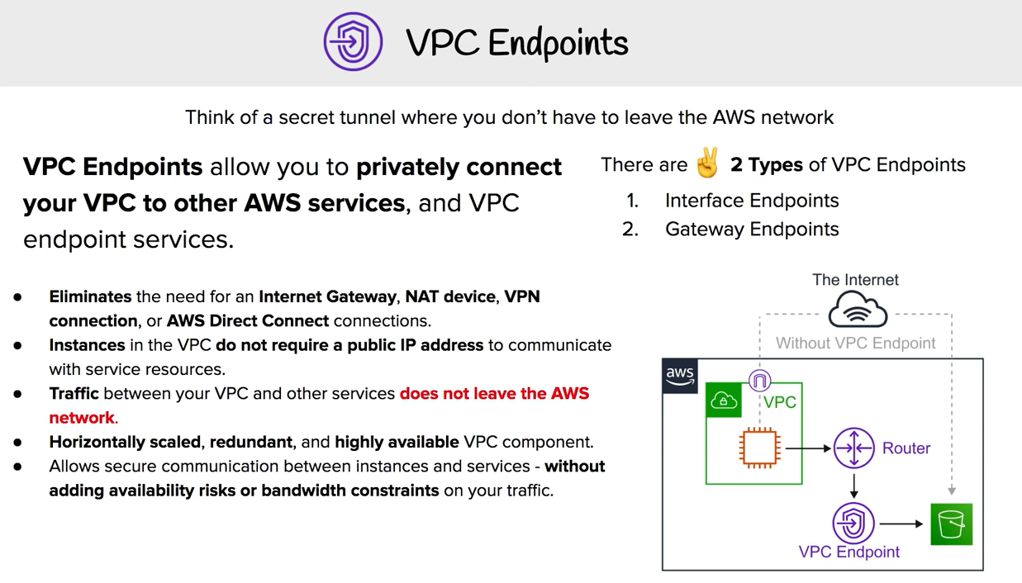

Slide 39
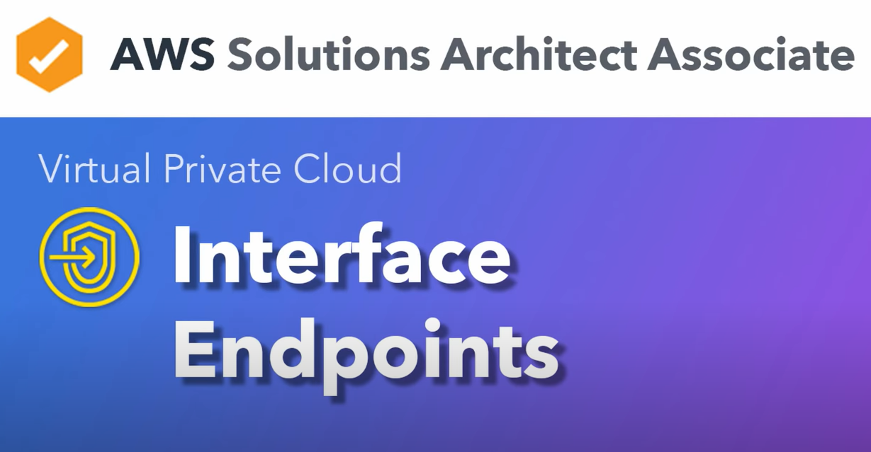

Slide 40
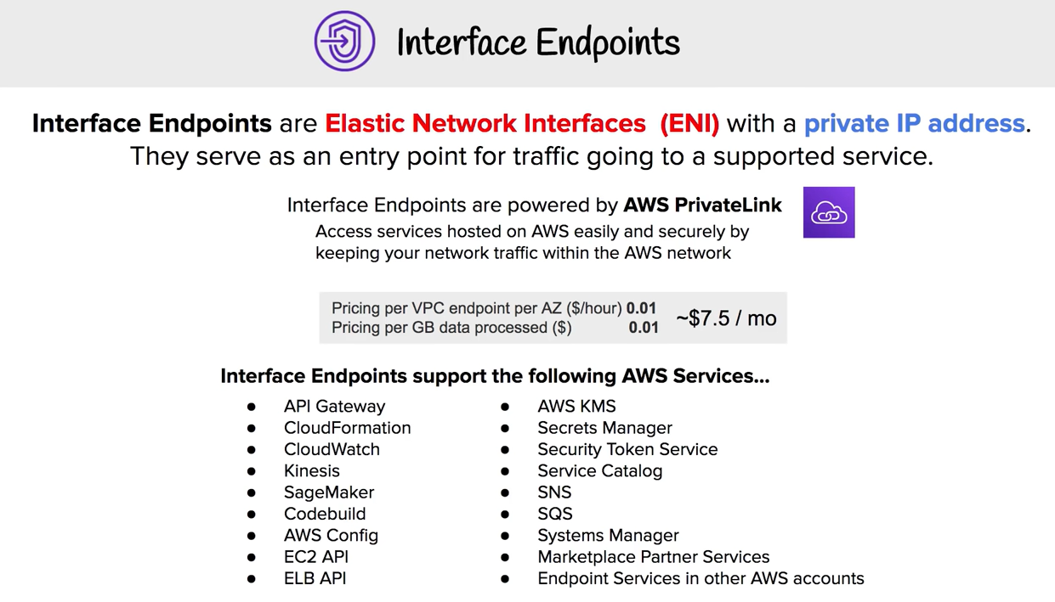

Slide 41
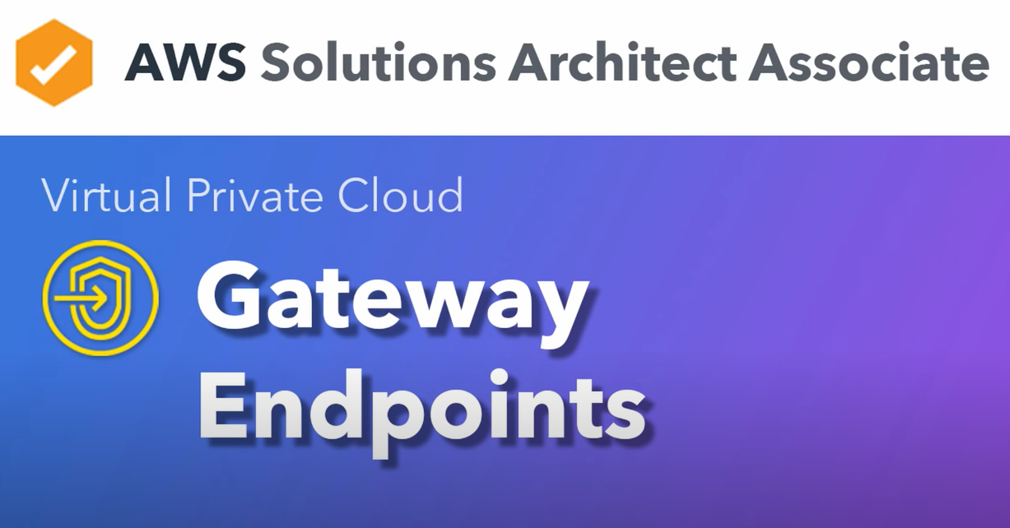

Slide 42
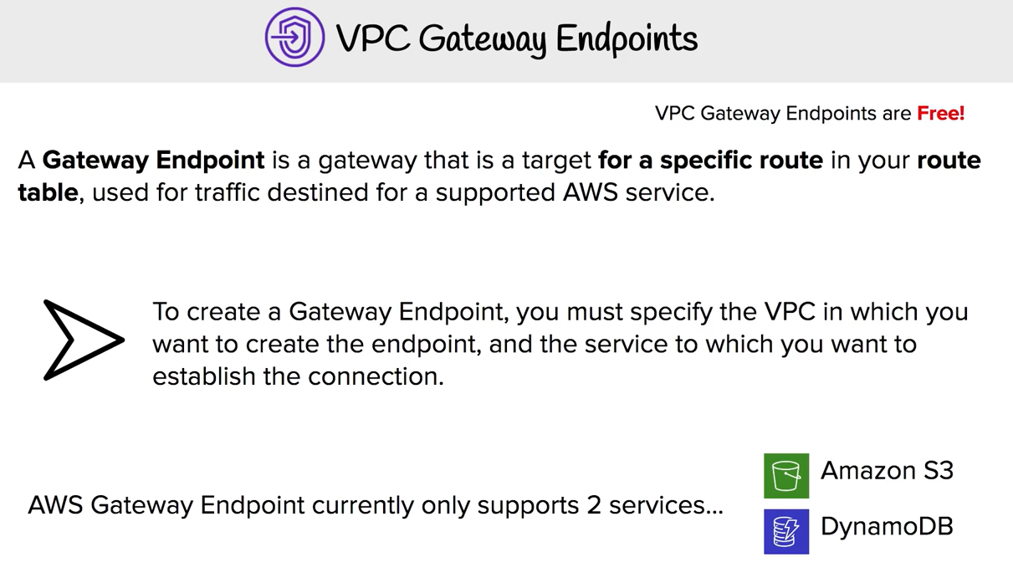

Slide 43
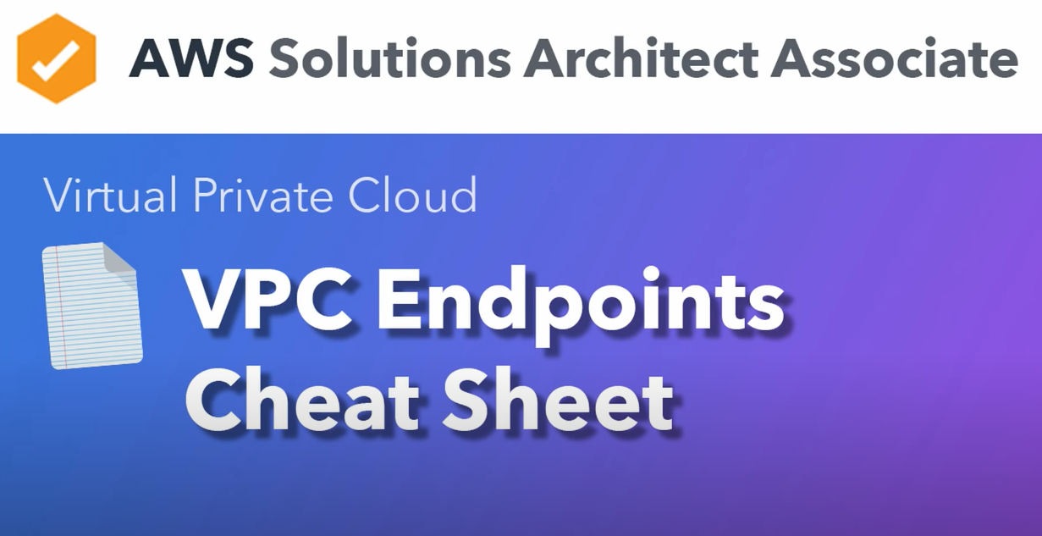

Slide 44
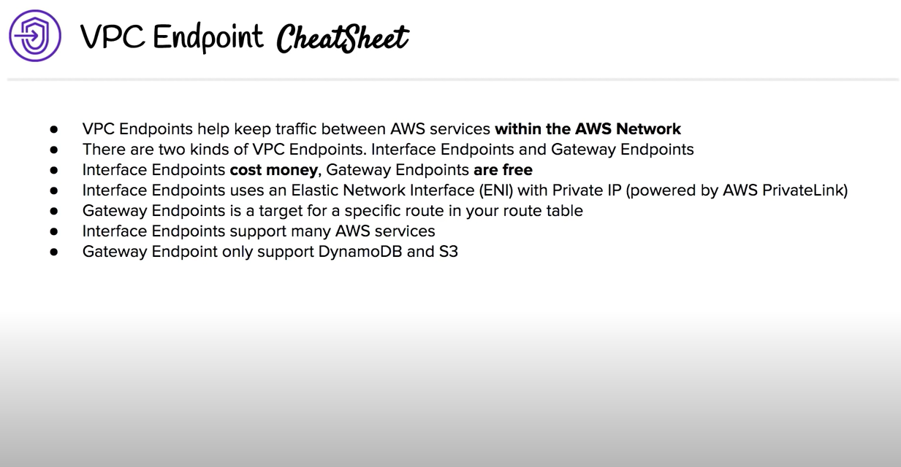

Slide 45
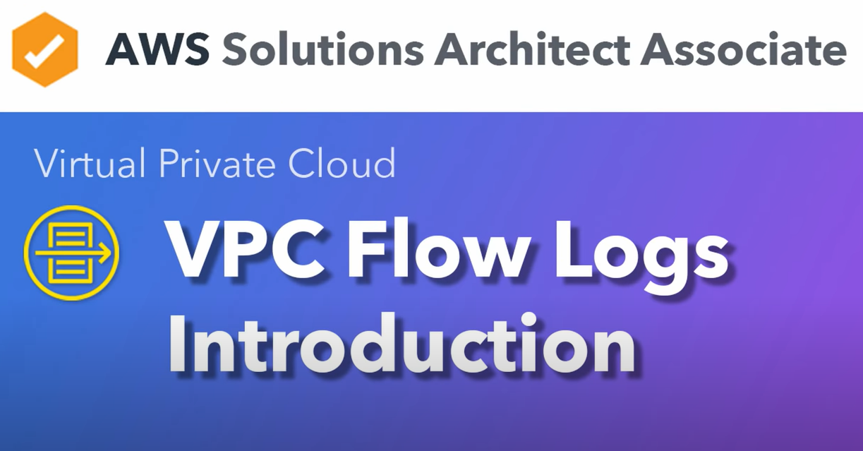

Slide 46
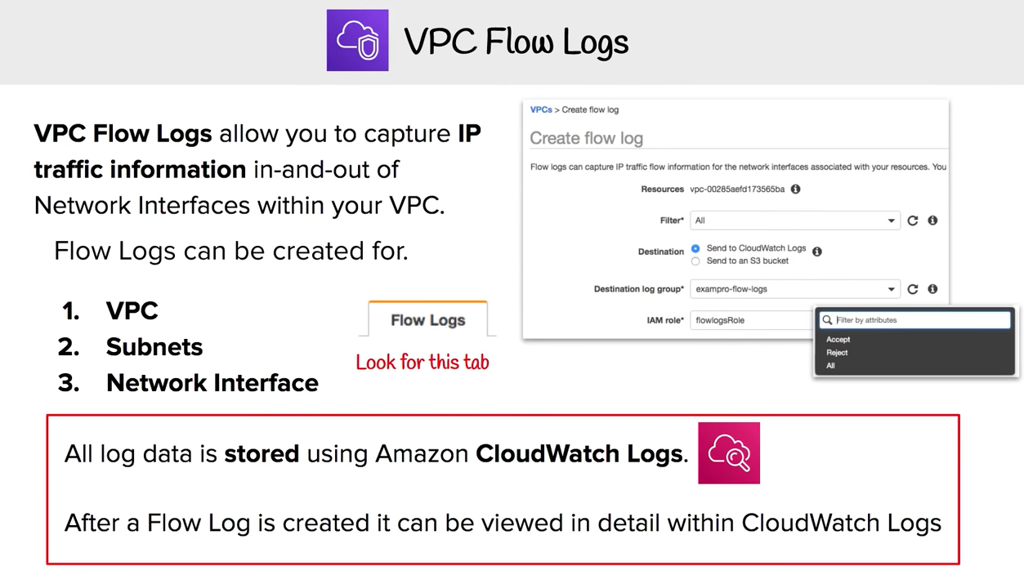

Slide 47
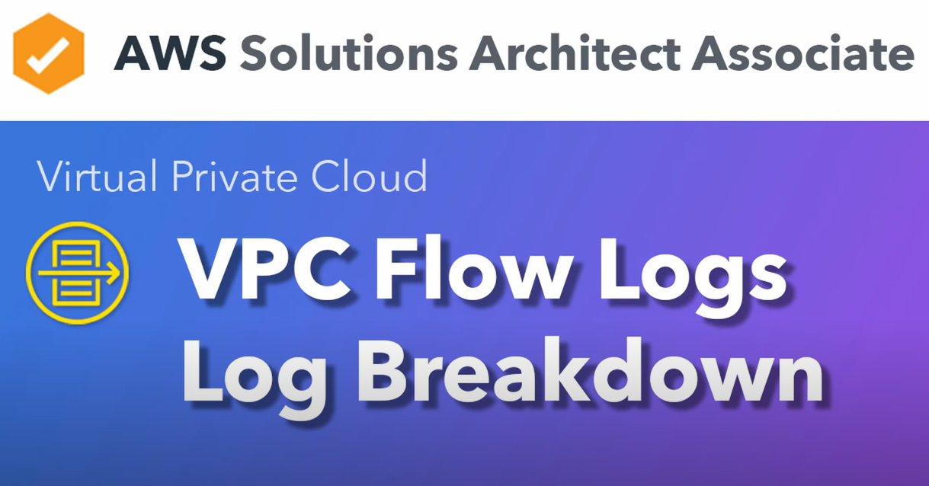

Slide 48
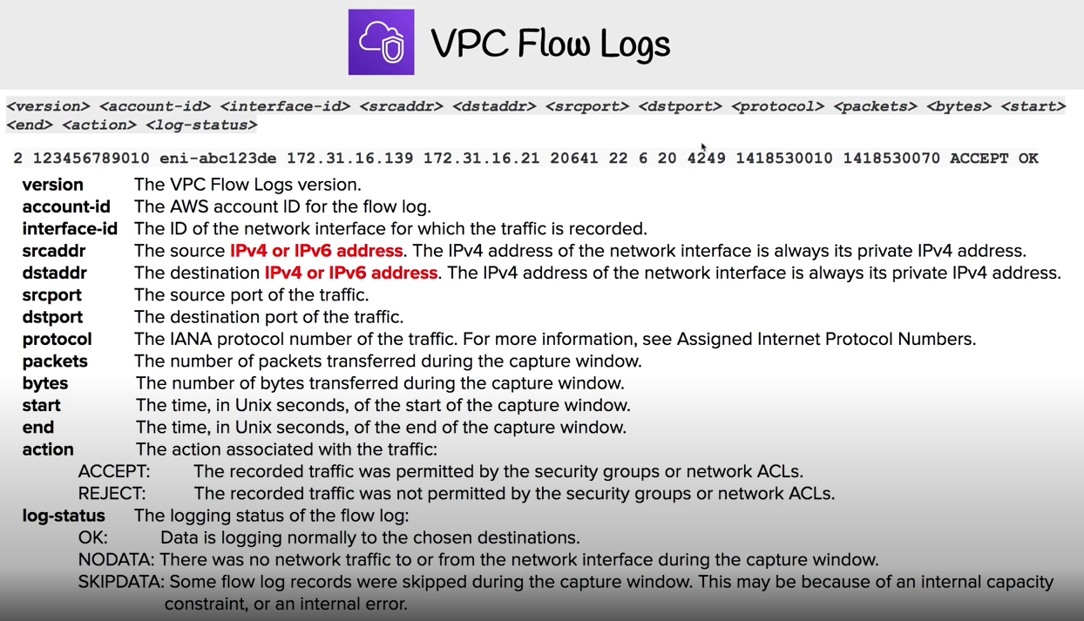

Slide 49
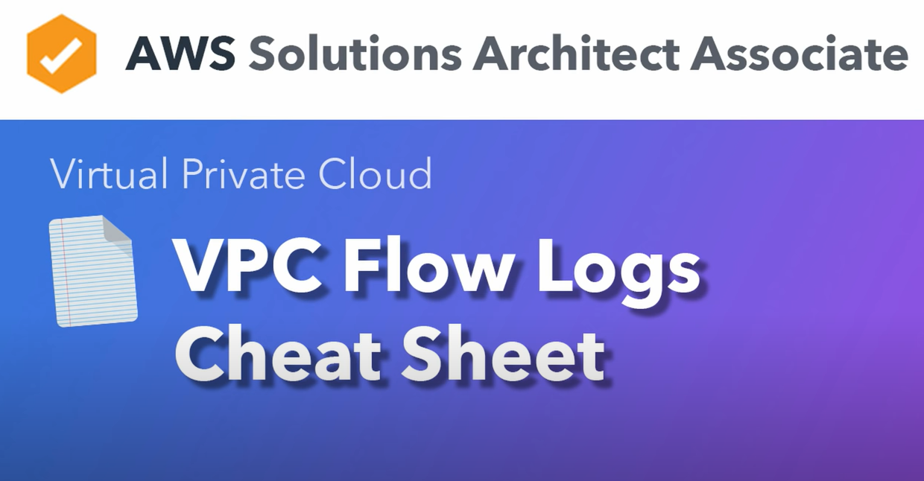

Slide 50
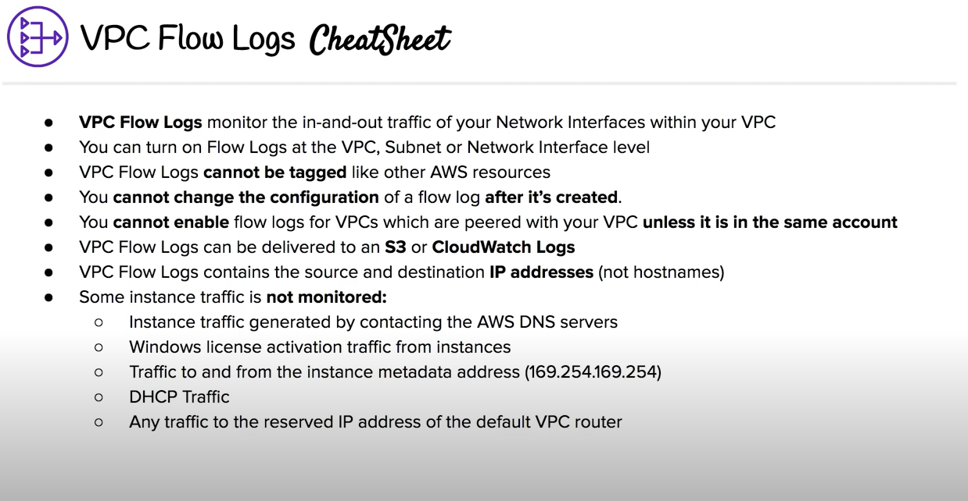

Slide 51
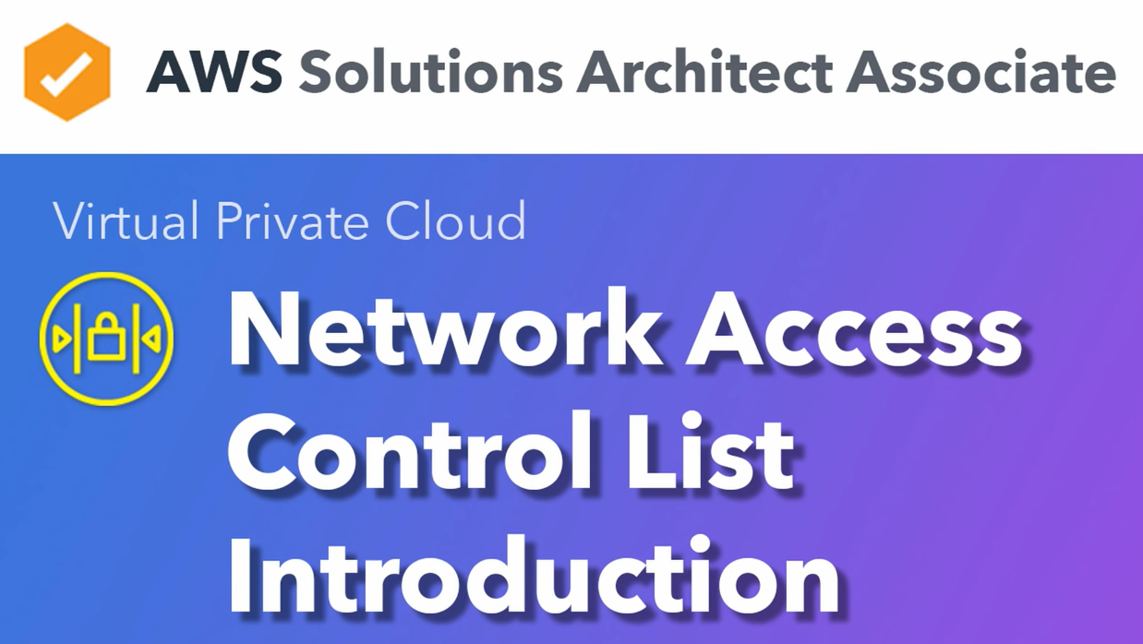

Slide 52
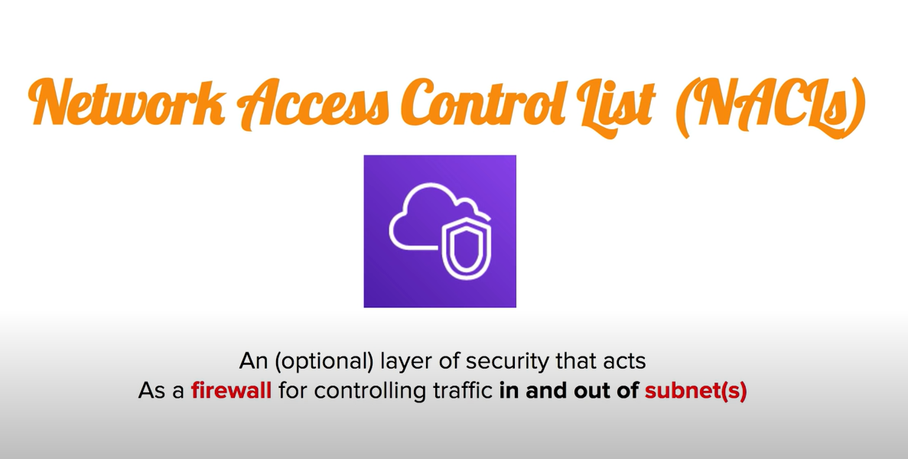

Slide 53
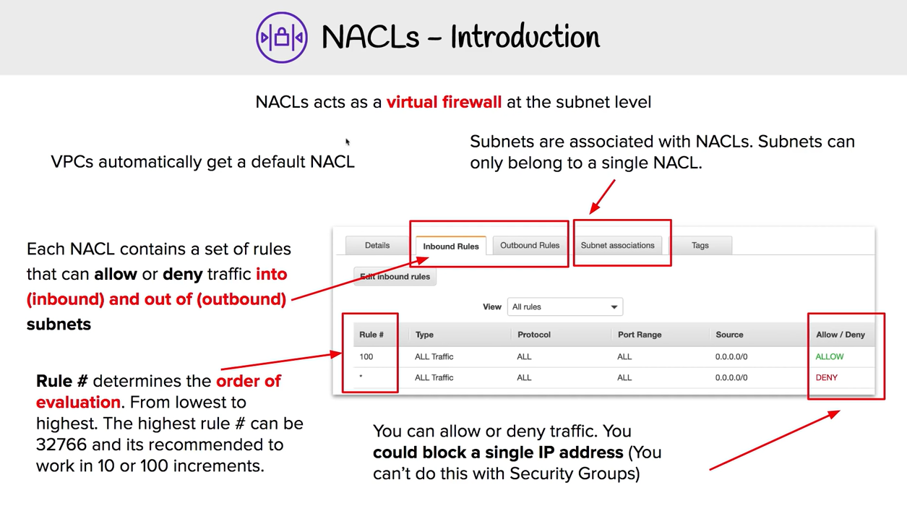

Slide 54
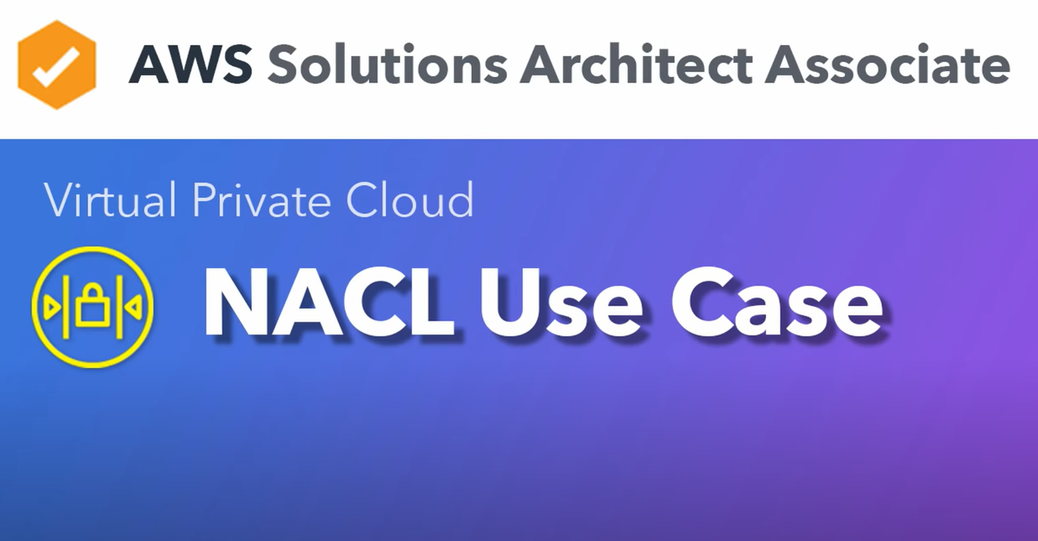

Slide 55
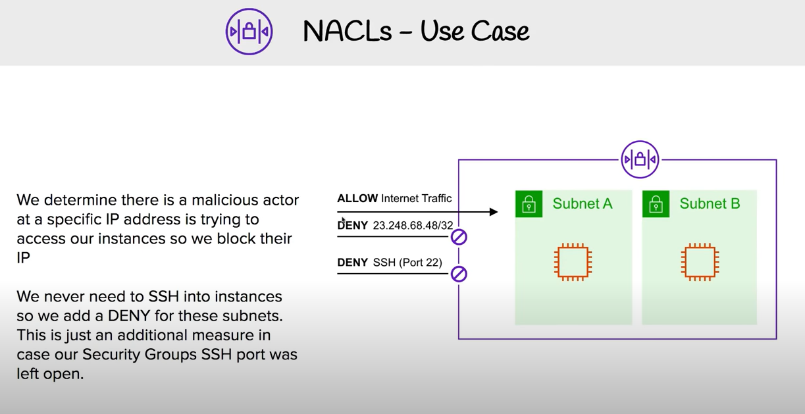

Slide 56


Slide 57


Slide 58


Slide 59


Slide 60


Slide 61


Slide 62


Slide 63


Slide 64


Slide 65


Slide 66


Slide 67


Slide 68


Slide 69


Slide 70


Slide 71


Slide 72


Slide 73


Slide 74


Slide 75
Appendix

Slide 76

Appendix

